Slide 1
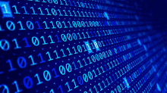




HELLO MY SELF
AKRITI MISHRA
I MADE THIS PRESENTION
0000
Cyber

Slide 2
INDEX
S.NO | UNIT | TOPIC | Page no
1 | I | Cyber security introduction-baisic | 5
2 | II | Security vulnerabilties,threats And attracks | 9
3 | III | Cyber threats-cyber-warfare | 11
4 | IV | National cyber security policy | 16
5 | V | National cyber security policy ii | 18
6 | VI | Cyber forensics | 22
7 | VII | Social media marketing | 23

Slide 3
Introduction to Cyber Security
Cyber Security Introduction - Cyber Security Basics:
Cyber security is the most concerned matter as cyber threats and attacks are overgrowing.
Attackers are now using more sophisticated techniques to target the systems. Individuals,
small-scale businesses or large organization, are all being impacted. So, all these firms
whether IT or non-IT firms have understood the importance of Cyber Security and focusing
on adopting all possible measures to deal with cyber threats.

Slide 4
What is cyber security?
"Cyber security is primarily about people, processes, and technologies working together to
encompass the full range of threat reduction, vulnerability reduction, deterrence, international
engagement, incident response, resiliency, and recovery policies and activities, including
computer network operations, information assurance, law enforcement, etc."
OR
Cyber security is the body of technologies, processes, and practices designed to protect
networks, computers, programs and data from attack, damage or unauthorized access.

Slide 5
Why is cyber security important?
Listed below are the reasons why cyber security is so important in what’s become a
predominant digital world:
• Cyber attacks can be extremely expensive for businesses to endure.
• In addition to financial damage suffered by the business, a data breach can also inflict
untold reputational damage.
• Cyber-attacks these days are becoming progressively destructive. Cybercriminals are
using more sophisticated ways to initiate cyber attacks.

Slide 6
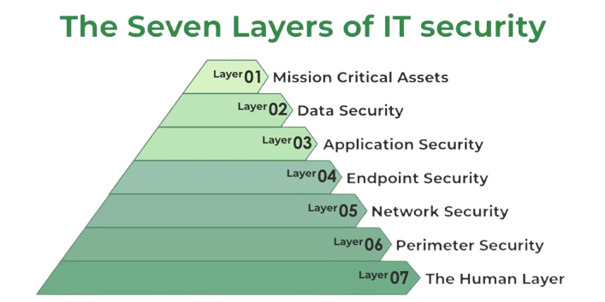

Slide 7
Unit II
CYBERSPACE AND THE LAW
CYBER FORENSICSCYBERSPACE
Cyberspace can be defined as an intricate environment that involves interactions between
people, software, and services. It is maintained by the worldwide distribution of information
and communication technology devices and networks.
With the benefits carried by the technological advancements, the cyberspace today has
become a common pool used by citizens, businesses, critical information infrastructure,
military and governments in a fashion that makes it hard to induce clear boundaries among
these different groups.

Slide 8
19
NATIONAL CYBER SECURITY
NATIONAL CYBER SECURITY POLICY
National Cyber Security Policy is a policy framework by Department of Electronics
Information Technology.
It aims at protecting the public and private infrastructure from
cyberattacks. The policy also intends to safeguard "information, such as personal information
(of web users), financial and banking information and sovereign data".
This was particularly relevant in the wake of US National Security Agency (NSA) leaks that suggested the US government agencies are spying on Indian users, who have no legal or technical safeguards
against it.
19

Slide 9
SECURITY VULNERABILITIES, THREATS AND ATTACKS –
Categories of vulnerabilities
• Corrupted (Loss of integrity)
• Leaky (Loss of confidentiality)
• Unavailable or very slow (Loss of availability)
– Threats represent potential security harm to an asset when vulnerabilities are exploited
- Attacks are threats that have been carried out
• Passive – Make use of information from the system without affecting system
resources
• Active – Alter system resources or affect operation

Slide 10
Cyber Threats-Cyber Warfare:
Cyber warfare refers to the use of digital attacks -- like
computer viruses and hacking -- by one country to disrupt the vital computer systems of another, with the aim of creating damage, death and destruction. Future wars will see
hackers using computer code to attack an enemy's infrastructure, fighting alongside troops using conventional weapons like guns and missiles.
Cyber warfare involves the actions by a nation-state or international organization to attack and attempt to damage another nation's computers or information networks through,
for example
computer viruses or denial-of-service attacks

Slide 11
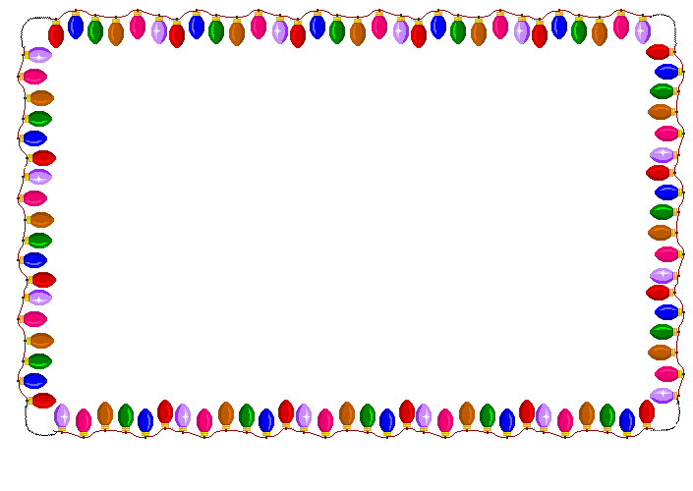

Slide 12
INTRODUCTION: CYBER FORENSICS
CYBER FORENSICS:
Computer forensics is the application of investigation and analysis techniques to gather and preserve evidence.
Forensic examiners typically analyze data from personal computers, laptops, personal digital
assistants, cell phones, servers, tapes, and any other type of media. This process can involve
anything from breaking encryption, to executing search warrants with a law enforcement
team, to recovering and analyzing files from hard drives that will be critical evidence in the
most serious civil and criminal cases.

Slide 13
DIGITAL FORENSICS:
Digital Forensics is defined as the process of preservation, identification, extraction, and documentation of computer evidence which can be used by the court of law.
It is a science of finding evidence from digital media like a computer, mobile phone, server, or network.
It provides the forensic team with the best techniques and tools to solve complicated digitalrelated cases.
DIGITAL FORENSICS LIFECYCLE:

Slide 14

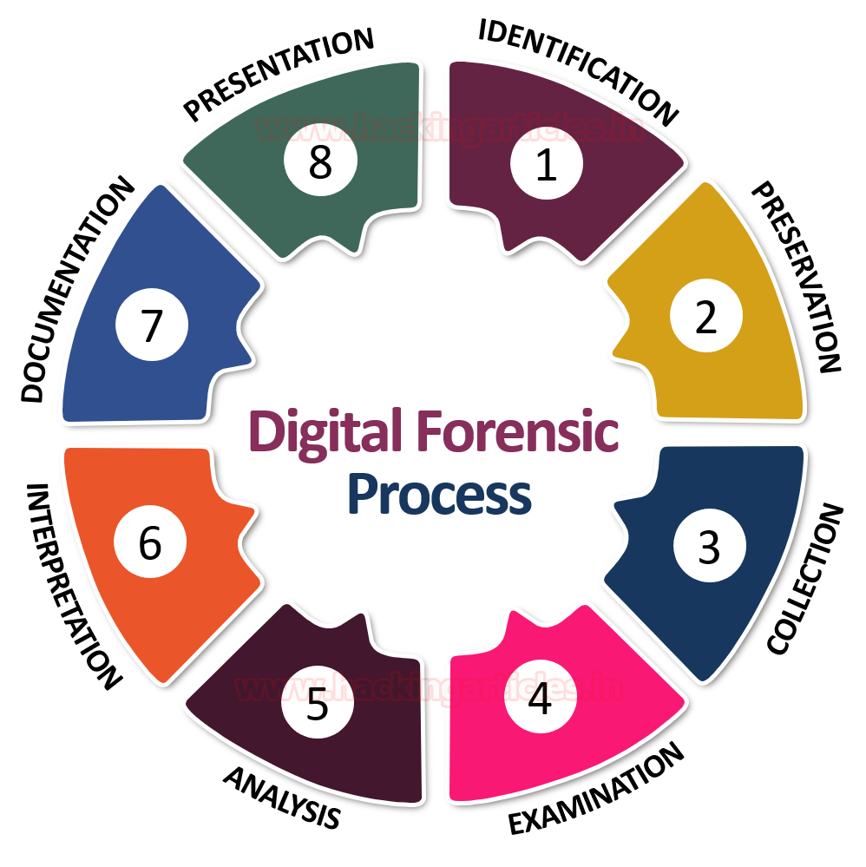

Slide 15
CYBER CRIME AND SOCIAL MEDIA MARKETING
Introduction
The internet or the superhighway has stretched its foot from one pole to another and touching lives of every human being.
In this article we discuss about the contradictory effect of the internet also keeping in mind, its benefits and power.
Due to its ease because of superfast progress in the technology, the information superhighway has become a necessity for every person.

Slide 16

Social Media
Social Media can be called as the third party tool that provides platform for public and business organizations to create exchange and communicate various forms of information and ideas in virtual group and networks.
to define social media is a challenging
task because of its unsteadiness since its emergence, but it has
been a boon to mankind because of the way it includes internet
based application which allow the user to connect to the rest of
the world, create and share information

Slide 17
Social Media Marketing
Social media marketing (SMM) is a form of internet marketing that utilizes social networking websites as a marketing tool.
The goal of SMM is to produce content that users will share with their social network to help a company increase brand exposure and broaden customer reach.
Modern day businesses are benefitting from social media as it
gives a great platform to advertise, it also allows connecting with
the customers helping business to analyze customer review about
a product or their services.

Slide 18


